Slide 1
Contribution-based Compensation and Appraisal System (CCAS) Introduction and Overview
The following slides may be slightly different when you access CAS2Net due to continuing refinement of CAS2Net.

Slide 2
CAS2Net Login
https://acqdemoii.army.mil
Use
https://cas2net.army.mil
and Save to Favorites
Click “I Agree”

Slide 3
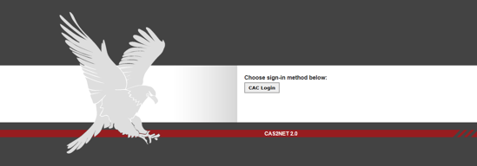
CAS2Net Login
Click

Slide 4
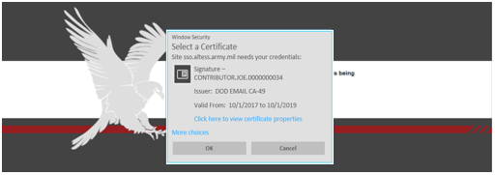
CAS2Net Login
Click

Slide 5
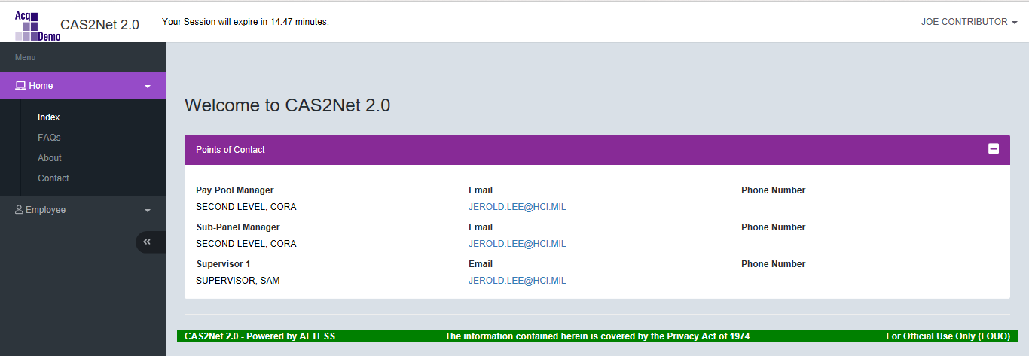
CAS2Net Login
1. Enter Pin
2. Click

Slide 6
CAS2Net Overview – Menu / Home / Welcome
Navigation Menu
(Click on Menu Item to Open)

Slide 7
CAS2Net Overview > Menu > Home > FAQs
Select /Click

Slide 8
CAS2Net – Overview > Menu > Home > About
Select /Click

Slide 9
CAS2Net – Overview – Session Countdown Timer
Session Countdown Timer

Slide 10
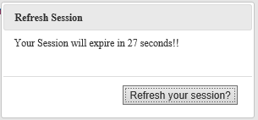
CAS2Net – Overview – Session Countdown Timer
After the 1:00 minute mark, the screen will turn grey with the option to “Refresh Your Session”.
CAS2Net 2.0 Your Session will expire in 52 seconds!!
JOE CONTRIBUTOR 
Click

Slide 11
CAS2Net – Overview – Session Countdown Timer
Your Session Has Expired!
Click
To Start
Login Process

Slide 12
CAS2Net – Overview – Logout
Click 
Your User Name is at the upper right corner of the screen

Slide 13
CAS2Net – Overview > Logout
Click 
Your User Name is at the upper right corner of the screen
Click
To Logout

Slide 14
CAS2Net – Overview > Edit Profile
Your User Name is at the upper right corner of the screen
Click

Slide 15
CAS2Net – Overview > Edit Profile > User Profile
Each User Profile has five panels…
Click to Expand Panel
Panel 1
Panel 2
Panel 3
Panel 4
Panel 5

Slide 16
CAS2Net – Overview > Edit Profile > User Profile General User Information
User can only update:
Click to Collapse Panel
Source document for the information is the User’s SF-50’s

Slide 17
CAS2Net – Overview > Edit Profile > User Profile Organization Information
For Information Only – Not Editable by User

Slide 18
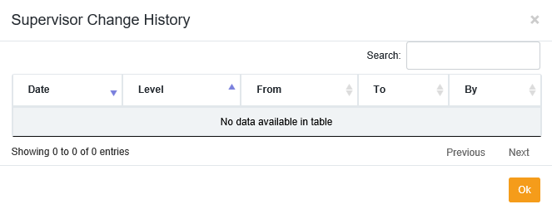
CAS2Net – Overview > Edit Profile > User Profile Organization Information
If you click
For Information Only – Not Editable by User
Popup

Slide 19
CAS2Net – Overview > Edit Profile > User Profile Salary Information
For Information Only – Not Editable by User

Slide 20
CAS2Net – Overview > Edit Profile > User Profile Organization Roles
For Information Only – Not Editable by User
Organization Roles in the Pay Pool process are:
Manager
Secondary Manager
Administrator
Super User
Most User Profiles will not have any data

Slide 21
CAS2Net – Overview > Edit Profile > User Profile Trusted Users
For Information Only – Not Editable by User
A Trusted User is a CAS2Net user who will serve as the backup for a specific Supervisor who may be unavailable to perform the Supervisor function in CAS2Net.
The Trusted Agent functionality is assigned by the Pay Pool Superuser to an user to perform another user’s supervisory role. The user who inherits the new role is known as the “Trusted Agent”. There is an audit function that will identify that the source of the action was the trusted agent.

Slide 22
CAS2Net – Overview > Edit Profile > User Profile Exit User Profile
To exit User Profile, click Cancel
or use the Navigation Menu to another selection
Click
To Exit

Slide 23
CAS2Net – Overview > Contact
Should this be changed to
usarmy.radford.peo-eis.other.service-desk@mail.mil
Your first point of contact should be your supervisor or your pay pool administrator.
As of 22 Feb 2019

Slide 24
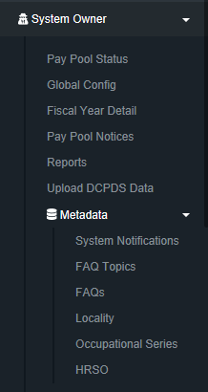
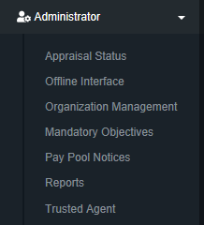
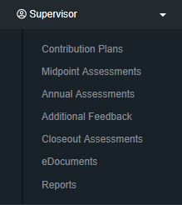
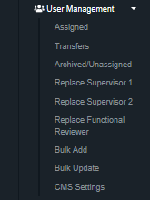
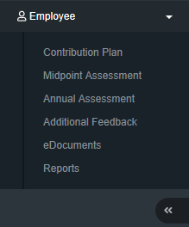
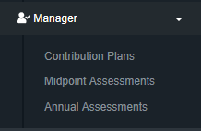
CAS2Net – Overview Menus for Different Users

Slide 25
CAS2Net – Overview > Menu > Home > Employee Information Panels for Different Users
Panel 1 – User Notifications
Panel 2 – Points of Contact

Slide 26
CAS2Net – Overview > Menu > Home > Supervisor Information Panels for Different Users
Panel 1 – User Notifications
Panel 2 – Points of Contact
Panel 3 – Supervisor 1 Dashboard
Panel 4 – Supervisor 2 Dashboard

Slide 27
CAS2Net – Overview > Menu > Home > Manager Information Panels for Different Users
Panel 1 – Points of Contact
Panel 2 – Manager Dashboard
Panel 3 – Supervisor 1 Dashboard
Panel 4 – Supervisor 2 Dashboard

Slide 28
CAS2Net – Overview > Menu > Home > Manager Information Panels for Different Users
Panel 1 – User Notifications
Panel 2 – Points of Contact
Panel 3 – Manager Dashboard
Panel 4 – Supervisor 1 Dashboard
Panel 5 – Supervisor 2 Dashboard

Slide 29
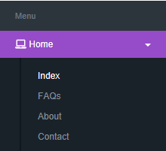
CAS2Net Enhancements > Home > Index Notifications and POCs
Five Most Recent User Notifications
Points of Contact Information

Slide 30
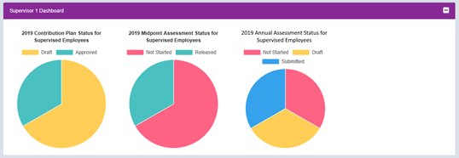
CAS2Net Enhancements > Home > Index Dashboards for Supervisors
Supervisor 1 Dashboard
Click on Pie Slice for Employee Detail
Employee Detail
(Click on Name to Open File)

Slide 31
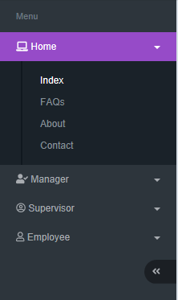
CAS2Net Enhancements > Home > Index Some Pay Pool Business May Require Supervisor 2 Approval Contribution Plan, Midpoint Assessment, Closeout Assessment, Additional Feedback, and Annual Assessment
Supervisor 2 Dashboard
Click on Pie Slice for Employee Detail
Employee Detail
(Click on Name to Open File)

Slide 32
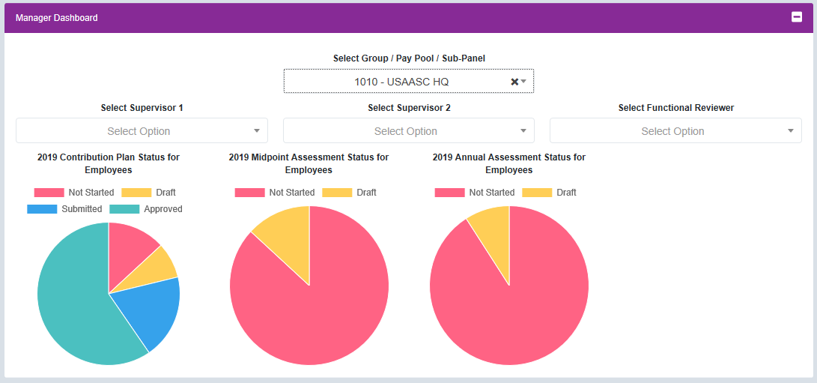
CAS2Net Enhancements > Home > Index Dashboards for Manager
Click on Pie Slice for Employee Detail
Employee Detail
(Click on Name to Open File)

Slide 33
CAS2Net Enhancements – Session Countdown Timer Contribution Plan, Midpoint Assessment, Closeout Assessment, Additional Feedback, and Annual Assessment
Your Session will expire in 14:20 minutes.
Your Session will expire in 2:49 minutes.
Your Session will expire in 55 seconds.
Refresh Session
Your Session will expire in 55 seconds!
Refresh your session?
Click

Slide 34
CAS2Net Enhancements - Writing Tool Kit Contribution Plan, Midpoint Assessment, Closeout Assessment, Additional Feedback, and Annual Assessment
Cut/Copy/Paste/Paste as Plain Text/Paste from Word/
Save/Preview/Print/
Undo/Redo/Find/Replace/Select All
Bold/Italic/Underline
Decrease Indent/Increase Indent/
Maximize/Show Blocks
Insert Remove Numbered List/Insert Remove Bulleted/
Align Left/Center/Align Right/Justify/

Slide 35
CAS2Net Enhancements - Auto Save Contribution Plan, Midpoint Assessment, Closeout Assessment, Additional Feedback, and Annual Assessment
Auto Save is activated upon typing or pasting text
Auto Save after
300 seconds (5 minutes)
Best Practice to Save Often

Slide 36
CAS2Net Enhancements - Spell Check Contribution Plan, Midpoint Assessment, Closeout Assessment, Additional Feedback, and Annual Assessment

Slide 37
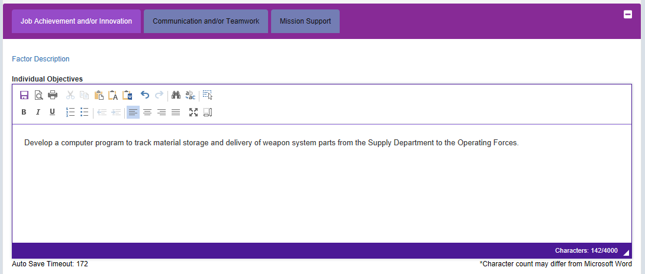
CAS2Net Enhancements – Hot Link to Factor Descriptors Contribution Plan, Midpoint Assessment, Closeout Assessment, Additional Feedback, and Annual Assessment
Click
“Factor Descriptors”
For
Hot Link to
Level Descriptors
See Next Slide

Slide 38
CAS2Net Enhancements – Hot Link to Factor Descriptors Contribution Plan, Midpoint Assessment, Closeout Assessment, Additional Feedback, and Annual Assessment

Slide 39
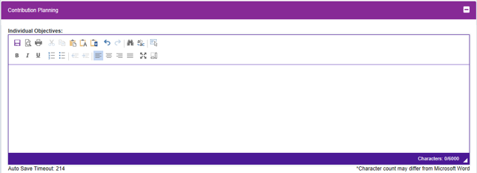
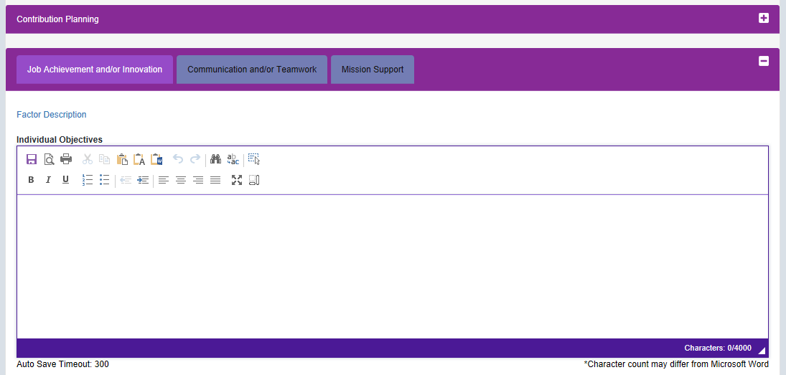
CAS2Net Enhancements – Contribution Plan
Still 6,000 Characters for Individual Objectives
Can Paste 5,400 Characters from Word Doc
Some Pay Pool Business May Require
Individual Employee Objectives for Each Contribution Factor
4,000 Characters Per Factor for Individual Objectives
Can Paste 3,600 Characters from Word Doc Per Factor

Slide 40
CAS2Net Enhancements – Contribution Plan
Some Pay Pool Business Rules May Require Mandatory Objective(s)

Slide 41
CAS2Net Enhancements – Contribution Plan
Some Pay Pool Business Rules May Require Objective(s) for Each Factor

Slide 42
CAS2Net Enhancement - Email Notification Whenever An Action Requires Review, Return and/or Approval Contribution Plan, Midpoint Assessment, Closeout Assessment, Additional Feedback, and Annual Assessment

Slide 43
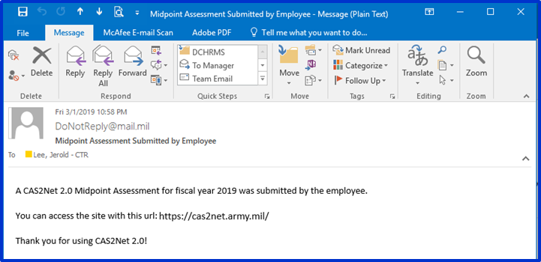
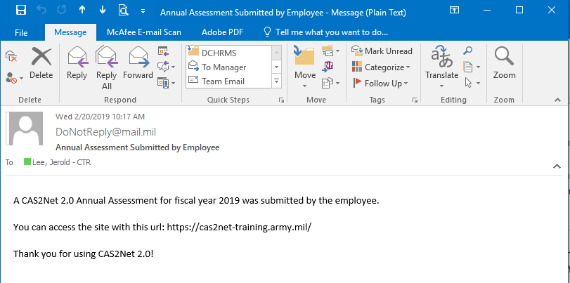
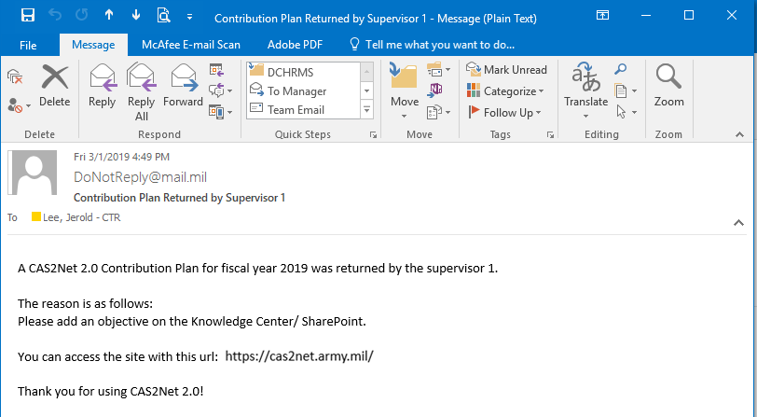
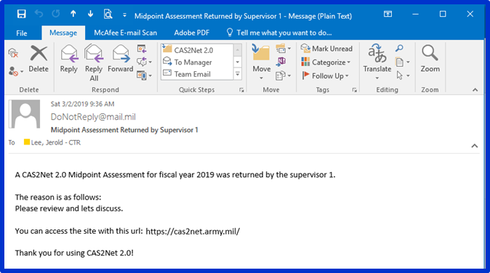
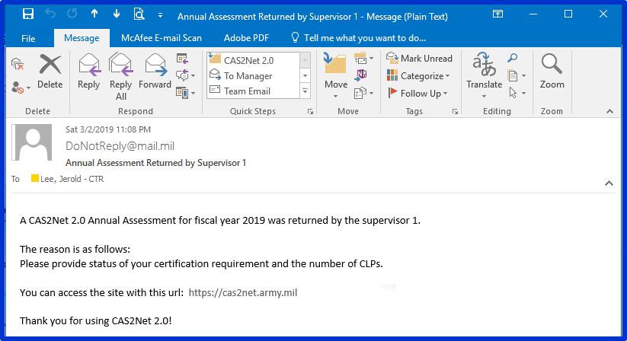
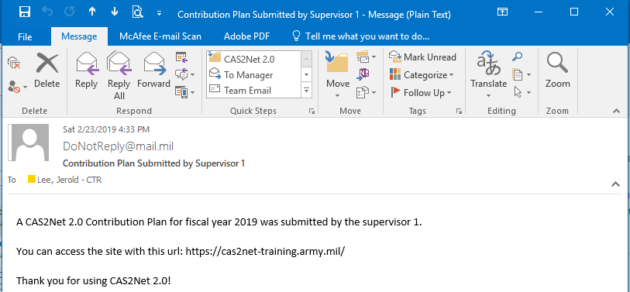
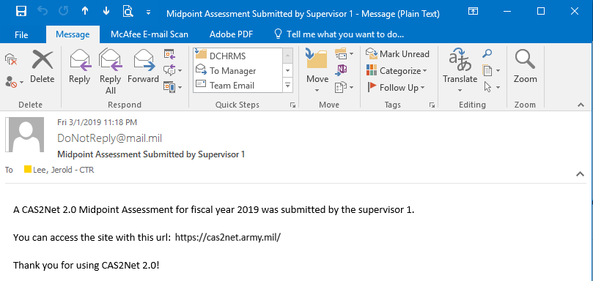
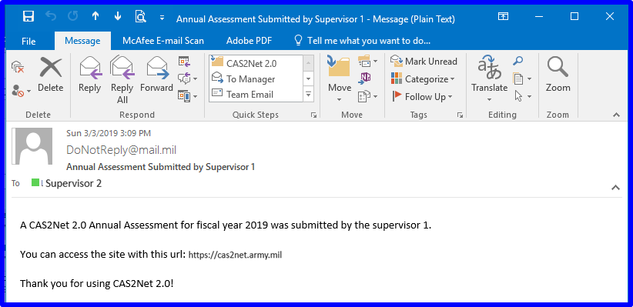
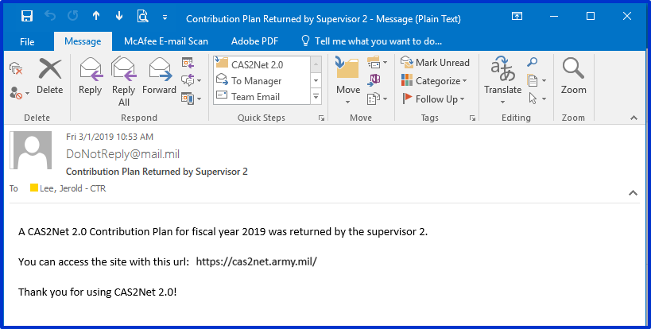
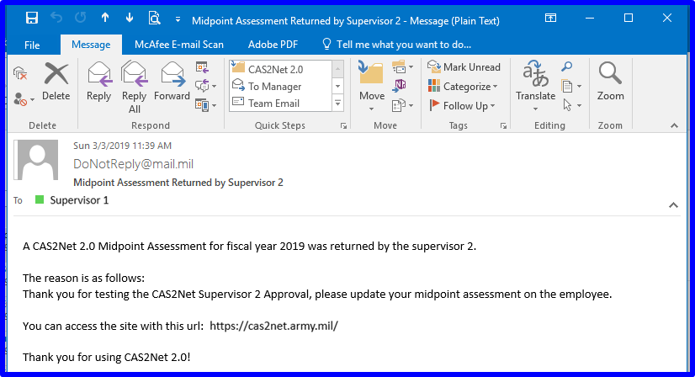
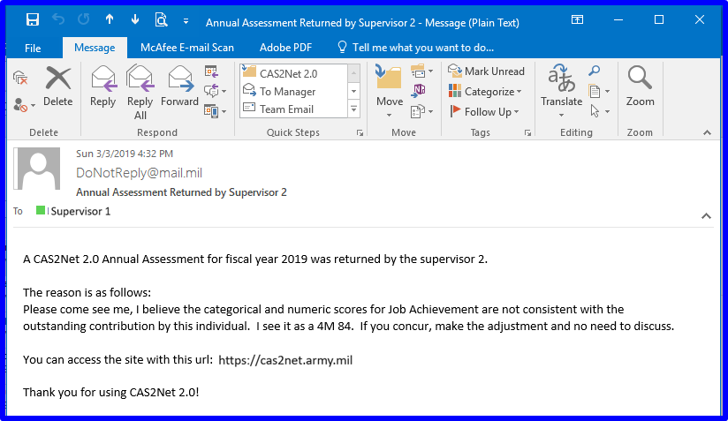
CAS2Net Enhancement - Email Notification Whenever An Action Requires Review, Return and/or Approval Contribution Plan, Midpoint Assessment, Closeout Assessment, Additional Feedback, and Annual Assessment
Contribution Plan
Midpoint Assessment
Annual Assessment
CAS2Net to Supervisor 1
CAS2Net to Supervisor 1
CAS2Net to Supervisor 1
CAS2Net will send an email to the user with approval authority (Supervisor 1 and Supervisor 2) and email on action returned to Employee and Supervisor 1, i.e., contribution plan, midpoint, closeout, and annual.
CAS2Net Return to Employee
CAS2Net Return to Employee
CAS2Net Return to Employee
CAS2Net to Supervisor 2
CAS2Net to Supervisor 2
CAS2Net to Supervisor 2
CAS2Net Return to Supervisor 1
CAS2Net Return to Supervisor 1
CAS2Net Return to Supervisor 1

Slide 44
CAS2Net Enhancement – Approved Contribution Plan Required for Midpoint and Annual Self-Assessment
If you see this message
it means your pay pool business rules require
an approved contribution plan in order to submit
a midpoint self-assessment and annual self-assessment.

Slide 45
CAS2Net Enhancements > Reports
Initial View
Once the Contribution Plan is approved, it is available in Reports
Approved Contribution Plan and Completed Midpoint

Slide 46
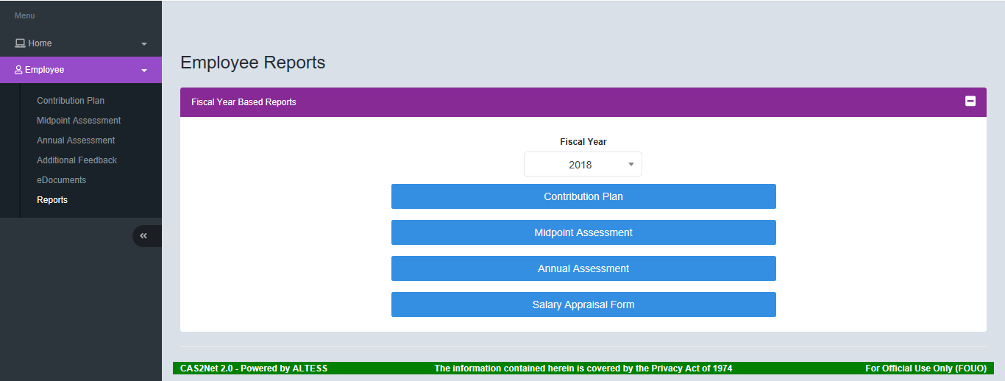
CAS2Net Enhancements > Reports
Current Year
Plus
Four Previous Years
Select
Click

Slide 47
CAS2Net Enhancements > Reports
Click
Select
Or open APPROVED Contribution Plan, Midpoint or Closeout to Generate PDF report
Click

Slide 48
CAS2Net Questions, Issues, Problems
Altess ServiceNow Service Desk
24/7/365
usarmy.radford.peo-eis.other.service-desk@mail.mil
or
1-800-981-3234

Slide 49
Contribution-based Compensation and Appraisal System (CCAS) Contribution Plan Mid-Point Closeout Annual
Employee
The following slides may be slightly different when you access CAS2Net due to continuing refinement of CAS2Net.

Slide 50
CAS2Net Login
Use
https://cas2net.army.mil
and Save to Favorites
1
2
5
Click
Click
3
Click
6
4
7
Enter

Slide 51
Contribution Plan - Employee
Click

Slide 52
Contribution Plan - Employee
Session Countdown Timer
Joe Contributor 
Panel 1
General Information
Panel 2
Contribution Planning
Action Buttons

Slide 53
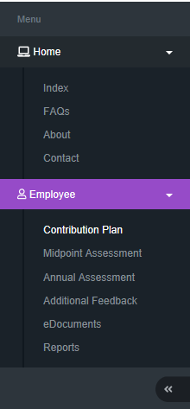
Contribution Plan - Employee
Click to
Expand Panel

Slide 54
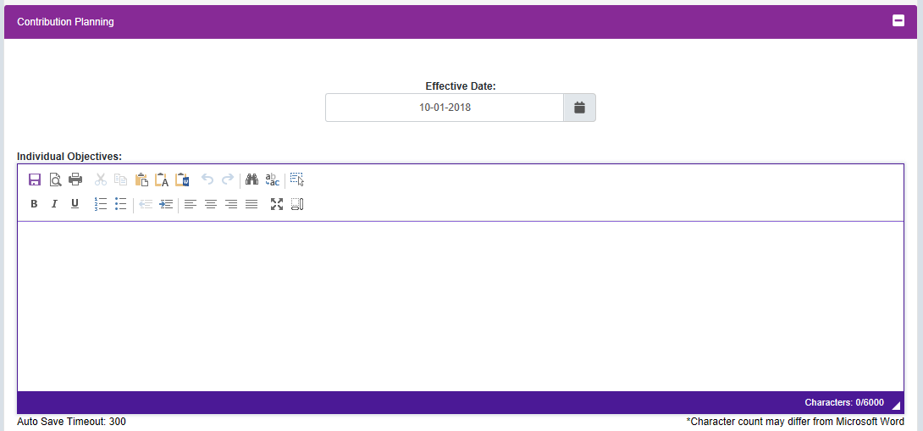
Contribution Plan - Employee
Note Status is Draft
Ensure Current Fiscal Year
Some Pay Pool Business Rules May Have Mandatory Objective(s) and/or Require Objectives for Each Factor.
(If in Slide Show, click this box to go to Mandatory Objectives)
6,000 Characters for Individual Objectives
Can Paste 5,400 Characters from Word Doc

Slide 55
Writing Tool Kit Contribution Plan, Midpoint Assessment, Closeout Assessment, Additional Feedback, and Annual Assessment
Cut/Copy/Paste/Paste as Plain Text/Paste from Word/
Save/Preview/Print/
Undo/Redo/Find/Replace/Select All
Bold/Italic/Underline
Decrease Indent/Increase Indent/
Maximize/Show Blocks
Insert Remove Numbered List/Insert Remove Bulleted/
Align Left/Center/Align Right/Justify/

Slide 56
Auto Save Contribution Plan, Midpoint Assessment, Closeout Assessment, Additional Feedback, and Annual Assessment
Auto Save is activated upon typing or pasting text
Auto Save after
300 seconds (5 minutes)
Best Practice to Save Often

Slide 57
Spell Check Contribution Plan, Midpoint Assessment, Closeout Assessment, Additional Feedback, and Annual Assessment

Slide 58
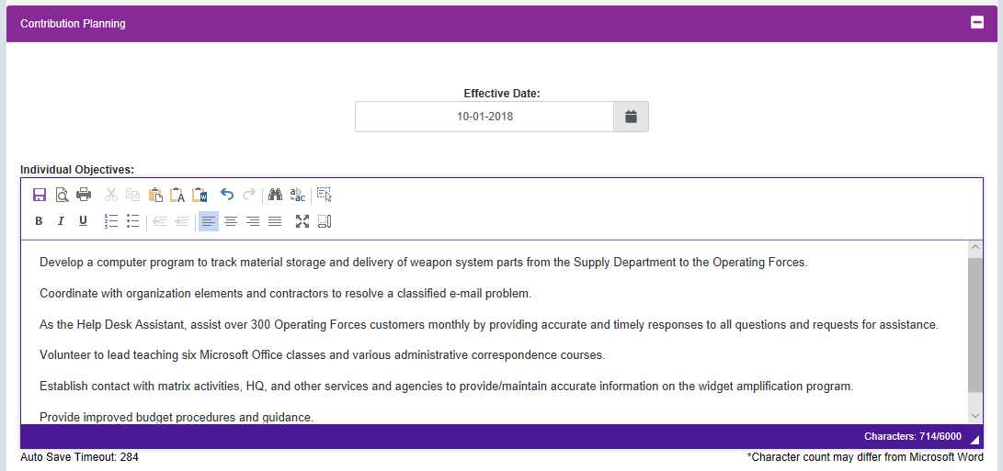
Contribution Plan - Employee
Enter Objectives

Slide 59
Contribution Plan - Employee
Click Save

Slide 60
Contribution Plan - Employee
Click Submit to Supervisor 1

Slide 61
Contribution Plan - Employee

Slide 62
Contribution Plan - Employee
Click

Slide 63
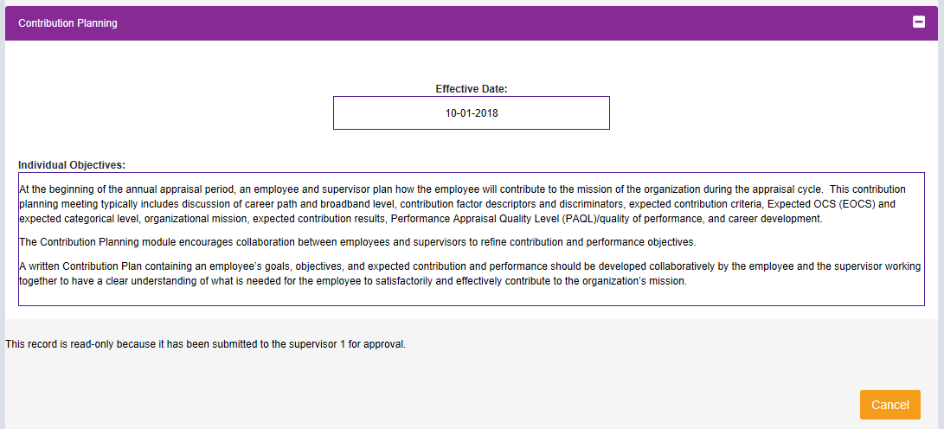
Contribution Plan - Employee
Note change from Draft to Submitted
Note

Slide 64
Contribution Plan - Employee
Click 
Click
To Logout

Slide 65
Contribution Plan with Mandatory Objectives and by Three Factors
Some Pay Pool Business Rules May Require Mandatory Objectives
Some Pay Pool Business Rules May Require Objectives for Each Factor

Slide 66
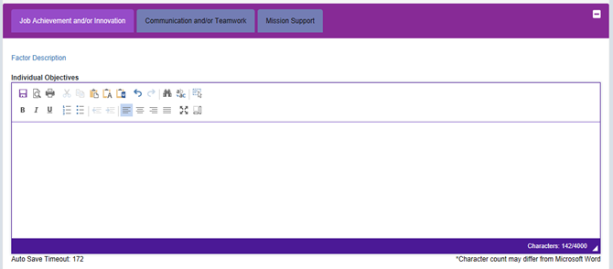
Contribution Plan by Three Factors - Employee
Mandatory Objective

Slide 67
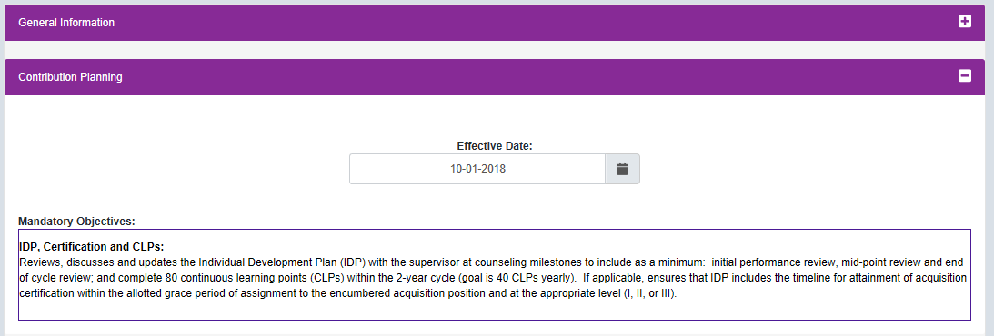
Contribution Plan by Three Factors - Employee
Click
“Factor Descriptors”
For
Hot Link to
Level Descriptors
See Next Slide
Three Factor Tabs

Slide 68
Contribution Plan by Three Factors - Employee Hot Link to Factor Level Descriptors

Slide 69
Contribution Plan by Three Factors - Employee
Type or Paste Text from Word Doc

Slide 70
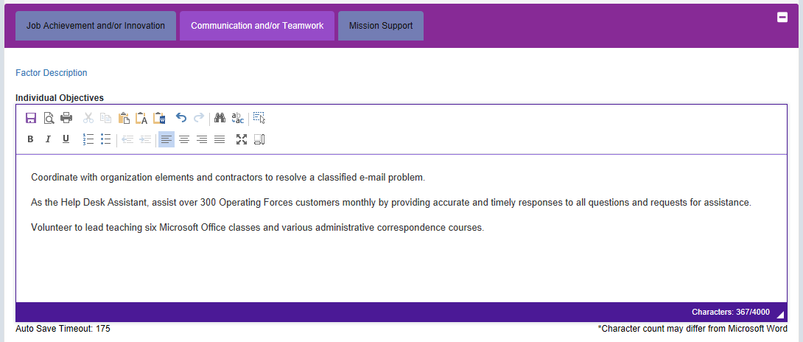
Contribution Plan by Three Factors - Employee
Type or Paste Text from Word Doc

Slide 71
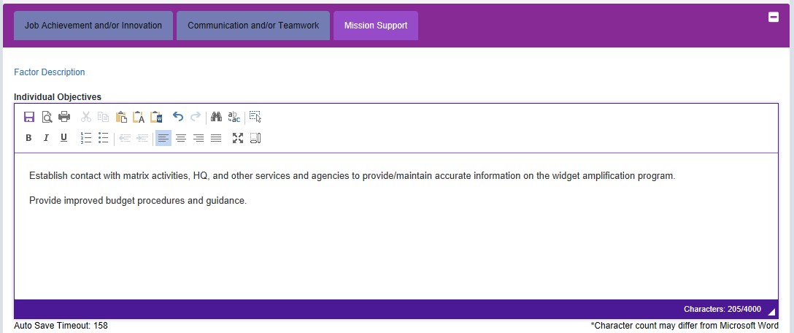
Contribution Plan by Three Factors - Employee
Type or Paste Text from Word Doc
Click

Slide 72
Contribution Plan by Three Factors - Employee
Type or Paste Text from Word Doc
Once Completed
Click Submit to Supervisor 1

Slide 73
Contribution Plan by Three Factors - Employee
Click

Slide 74
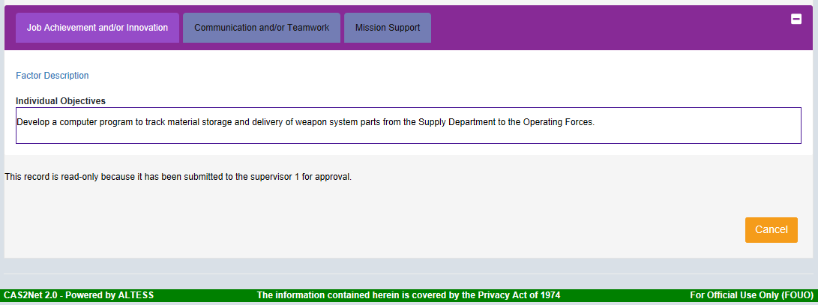
Contribution Plan by Three Factors - Employee
Note change from Draft to Submitted
Note

Slide 75
Contribution Plan Returned – Email Notification
Reason for Return to Employee

Slide 76
Contribution Plan Returned - Employee
Click 
Click
To Logout
Employee updates and submits Contribution Plan to Supervisor 1
Plan Submitted to Supervisor 1 for Approval

Slide 77
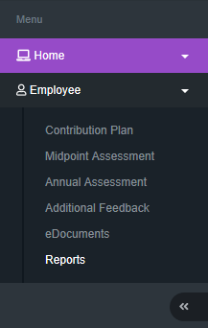
Contribution Plan – Email Notification
Once the supervisor has completed the review and discussion of the contribution plan with the employee, the supervisor documents this by entering the method and date of communication, and releases the approved plan to the employee. Method of communication could be face-to-face, tele-conference, video conference, email or other.
An email notification will not be sent when the contribution plan is approved because of the documented review and discussion between the employee and the supervisor.
With the release of the approved contribution plan, the employee can view and/or generate a file of the approved plan by going to Menu > Employee> Reports.

Slide 78
Contribution Plan – Employee - Reports
The Reports Section is populated with the APPROVED Contribution Plans, Midpoint Assessments, Closeout Assessments, Additional Feedback, Annual Assessments and Salary Appraisal Forms. In this slide, 2019 only has the approved Contribution Plan
And 2018 has the APPROVED plans, assessments and the Salary Appraisal Forms.

Slide 79
Contribution Plan – Employee - Reports
Two Options to Generate Approved Contribution Plan Report
Menu > Employee > Reports
Menu > Employee > Contribution Plan > Click Generate PDF
2019
Click
Click

Slide 80
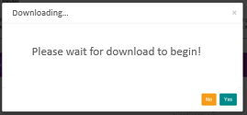
Contribution Plan – Generate Reports

Slide 81
Contribution Plan – Generate Reports
Click

Slide 82
Contribution Plan – Generated PDF

Slide 83
Contribution Plan – Log Out
Click 
Click
To Logout

Slide 84
CAS2Net Questions, Issues, Problems
Altess ServiceNow Service Desk
24/7/365
usarmy.radford.peo-eis.other.service-desk@mail.mil
or
1-800-981-3234

Slide 85
Contribution-based Compensation and Appraisal System (CCAS) Contribution Plan Mid-Point Closeout Annual
Supervisor
The following slides may be slightly different when you access CAS2Net due to continuing refinement of CAS2Net.

Slide 86
Contribution Plan Submitted – Email Notification
https://cas2net.army.mil/

Slide 87
CAS2Net Login
Use
https://cas2net.army.mil
and Save to Favorites
1
2
5
Click
Click
3
Click
6
4
7
Enter

Slide 88
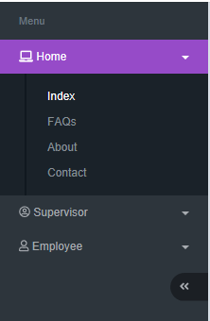
Contribution Plan – Overview - Supervisor
Session Countdown Timer
Panel
Panel
Navigation Menu
Panel

Slide 89
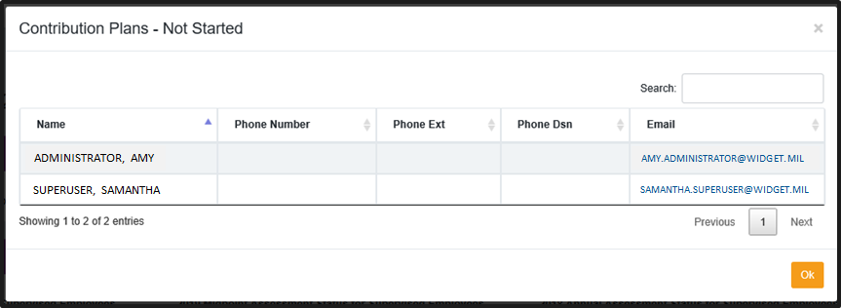
Contribution Plan - Supervisor
Click
Click

Slide 90
Contribution Plan - Supervisor
Click on Name/Row to Open Employee’s Contribution Plan
Or go to Navigation Menu and Click Supervisor > Contribution Plan

Slide 91
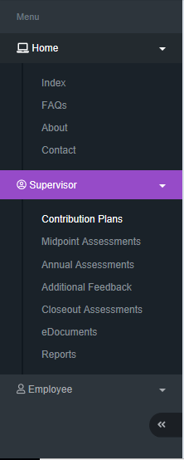
Contribution Plan - Supervisor
Click Contribution Plans to See Rated Employees

Slide 92
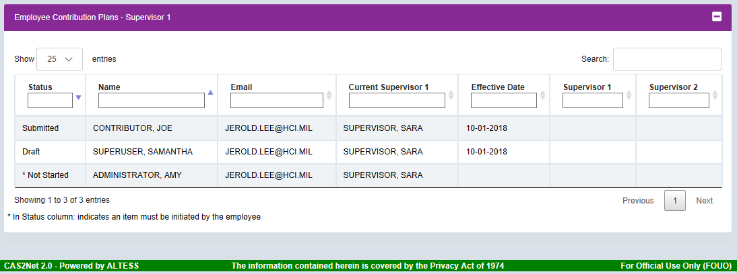
Contribution Plan - Supervisor
Ensure Current Fiscal Year

Slide 93
Contribution Plan - Supervisor
Employee has submitted to Supervisor 1


Slide 94
Contribution Plan - Supervisor
Click on Name/Row to Open Employee’s Contribution Plan

Slide 95
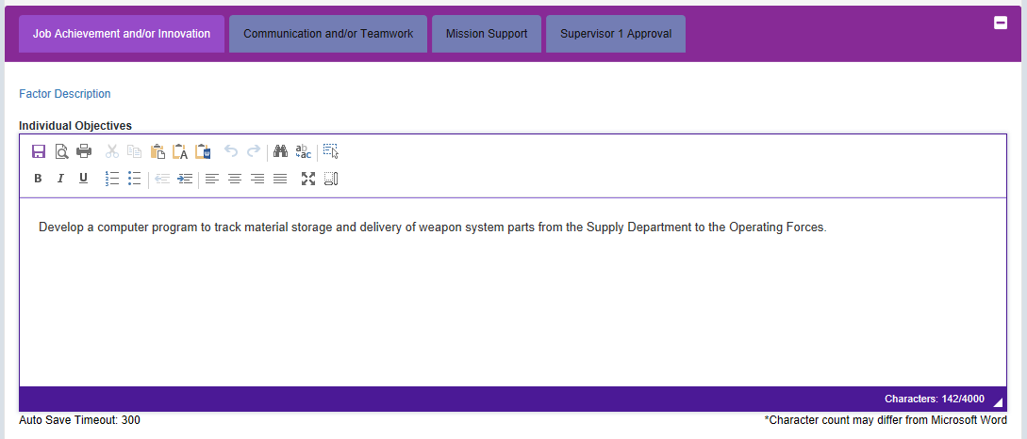
Contribution Plan - Supervisor
The Contribution Plan review process by the Supervisor is the same for Contribution Plans with Individual Objectives, Individual Objectives with Mandatory Objective(s), Individual Objectives by Three Factors, and Individual Objectives by Three Factors with Mandatory Objective(s).

Slide 96
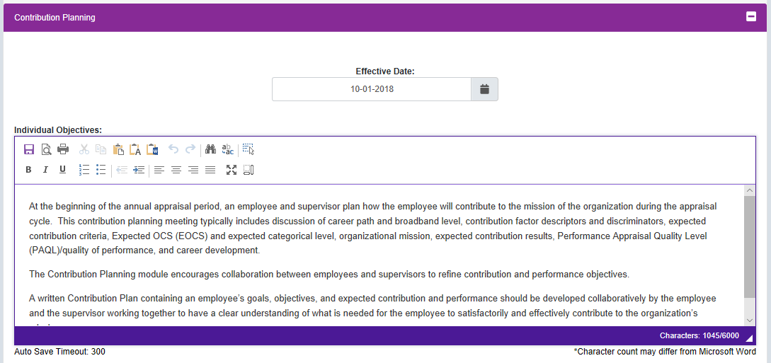
Contribution Plan - Supervisor
Note Submitted
Review
Review

Slide 97
Contribution Plan - Supervisor
Option

Slide 98
Contribution Plan - Supervisor
If returning Contribution Plan to employee, change to Slide Show then click on this button to go to Return to Employee
If Employee’s Contribution Plan is good, see next slide to approve…

Slide 99
Contribution Plan - Supervisor
Select Date
Check One
Check Box To Auto-Populate with Supervisor’s Name

Slide 100
Contribution Plan - Supervisor
Method and Date of Communication Completed
Click

Slide 101
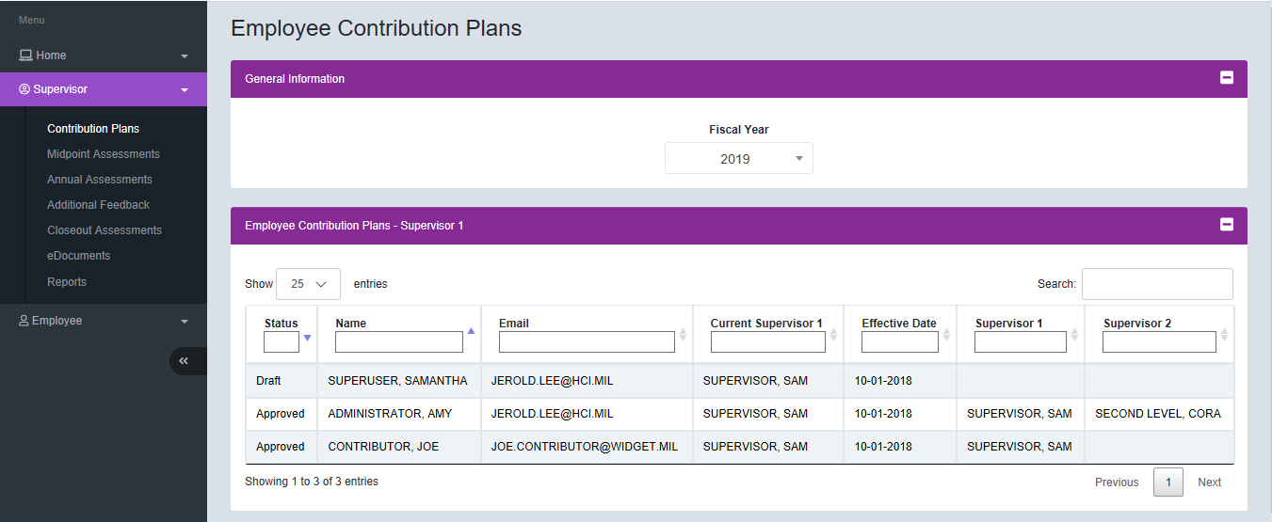
Contribution Plan - Supervisor
Click
Approved and Released to Employee

Slide 102
Contribution Plan - Supervisor
Note Change from Submitted to Approved

Slide 103
Contribution Plan – Supervisor – Generate PDF
Click to Print

Slide 104
Contribution Plan – Supervisor – Generate PDF
Downloading…
Please wait for download to begin!

Slide 105
Contribution Plan – Supervisor – Generate PDF
Click

Slide 106
Contribution Plan – Supervisor – Generated PDF

Slide 107
Contribution Plan - Supervisor
Click 
Click
To Logout
Note
Click on Pie Slice
Modify or Return Contribution Plan to Employee, go to next slide

Slide 108
Contribution Plan – Supervisor Return to Employee or Modify

Slide 109
Contribution Plan - Supervisor Modify / Return to Employee
Anytime after approving a contribution plan, the approved plan can be “Return to Employee” by the supervisor or “Modify” by the supervisor.
Click on “Approved” or the Employee’s Name/Row to open the contribution plan.

Slide 110
Contribution Plan - Supervisor Modify / Return to Employee
Click Return to Employee

Slide 111
Contribution Plan - Supervisor Modify / Return to Employee
If returning Contribution Plan to employee, enter justification
Click

Slide 112
Contribution Plan Returned – Email Notification
Email notification is not sent when the contribution plan is modified by the supervisor.
Reason for Return to Employee

Slide 113
Contribution Plan – Supervisor Modify
Click to Modify

Slide 114
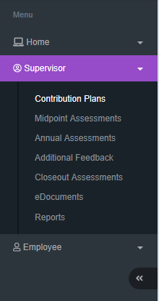
Contribution Plan – Supervisor Modify
Click
Method and Date of Communication Cleared

Slide 115
Contribution Plan – Supervisor Modify
1. Modified by Supervisor
2. Document review with employee by entering method and date of communication
3. Click Approve
4. Click Yes
Approved Plan

Slide 116
Contribution Plan – Supervisor - Reports
The Reports Section is populated with the APPROVED Contribution Plans, Midpoint Assessments, Closeout Assessments, Additional Feedback, Annual Assessments and Salary Appraisal Forms. In this slide, 2019 only has the approved Contribution Plan
And 2018 has the APPROVED plans, assessments and the Salary Appraisal Forms.

Slide 117
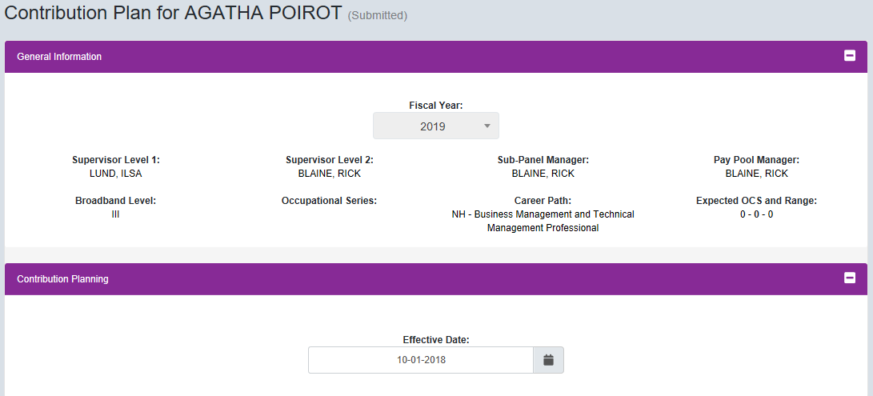
Contribution Plan – Supervisor 1 to Supervisor 2
Click

Slide 118
Contribution Plan – Supervisor 1 to Supervisor 2
Click

Slide 119
Contribution Plan – Supervisor 1 to Supervisor 2
Note
Note

Slide 120
Contribution Plan – Supervisor 1 to Supervisor 2
Click 
Click
To Logout
Note
“Ready for Supervisor 2 Approval”
See Next Slide for Supervisor 2 Approval

Slide 121
CAS2Net Questions, Issues, Problems
Altess ServiceNow Service Desk
24/7/365
usarmy.radford.peo-eis.other.service-desk@mail.mil
or
1-800-981-3234

Slide 122
Some Pay Pool Business Rules May Require Supervisor 2 Approval Contribution Plan Supervisor 2 Approval
The following slides may be slightly different when you access CAS2Net due to continuing refinement of CAS2Net.

Slide 123
Contribution Plan – Email Notification Supervisor 1 to Supervisor 2

Slide 124
CAS2Net Login
Use
https://cas2net.army.mil
and Save to Favorites
1
2
5
Click
Click
3
Click
6
4
7
Enter

Slide 125
Contribution Plan – Supervisor 2 Approval
Session Countdown Timer
Navigation Menu
Supervisor 2 Dashboard

Slide 126
Contribution Plan – Supervisor 2 Approval
Must Use
Supervisor Menu
for
Supervisor 2 Approval

Slide 127
Contribution Plan – Supervisor 2 Approval
Employee Contribution Plan Supervisor 2
Supervisor has approved and waiting for Supervisor 2 to approve


Slide 128
Contribution Plan – Supervisor 2 Approval
Click
On Name / Row

Slide 129
Contribution Plan – Supervisor 2 Approval
Review
Note: Read Only But Supervisor 2 Approval Require
Action Options

Slide 130
Contribution Plan – Supervisor 2 Approval
Review
Click Next Factor

Slide 131
Contribution Plan – Supervisor 2 Approval
Review
Click Next Factor

Slide 132
Contribution Plan – Supervisor 2 Approval
Review
Click Next Factor

Slide 133
Contribution Plan – Supervisor 2 Approval
Review
Method and Date of Communication
Click Approve

Slide 134
Contribution Plan – Supervisor 2 Approval
Changed from
Ready for Supervisor 2 Approval to Approved
Read Only, Approved

Slide 135
Contribution Plan – Supervisor 2 Approval
Click
Approved

Slide 136
Contribution Plan – Supervisor 1 Employee Detail

Slide 137
Contribution Plan - Supervisor 2 Return to Supervisor 1 or Modify

Slide 138
Contribution Plan – Supervisor 2 to Supervisor 1
Option to Return to Supervisor 1, see next slide

Slide 139
Contribution Plan – Supervisor 2 to Supervisor 1
If returning Contribution Plan to Supervisor 1, enter justification
Click

Slide 140
Contribution Plan Returned – Email Notification Supervisor 2 to Supervisor 1

Slide 141
Contribution Plan – Supervisor 2 to Supervisor 1
Supervisor 2
Supervisor 1

Slide 142
CAS2Net Questions, Issues, Problems
Altess ServiceNow Service Desk
24/7/365
usarmy.radford.peo-eis.other.service-desk@mail.mil
or
1-800-981-3234

Slide 143
Contribution-based Compensation and Appraisal System (CCAS) Contribution Plan Mid-Point Closeout Annual
Employee
The following slides may be slightly different when you access CAS2Net due to continuing refinement of CAS2Net.

Slide 144
Midpoint Assessment
If you see this message, your pay pool business rules require
an approved contribution plan
in order to initiate a midpoint self-assessment.

Slide 145
Midpoint Assessment – Employee
The Midpoint Self-Assessment process by the Employee is the same for Contribution Plans with Individual Objectives, Individual Objectives with Mandatory Objective(s), Individual Objectives by Three Factors, and Individual Objectives by Three Factors with Mandatory Objective(s).
Self-Assessment for each of the three factors
Self-Assessment for each of the three factors

Slide 146
CAS2Net Login
Use
https://cas2net.army.mil
and Save to Favorites
1
2
5
Click
Click
3
Click
6
4
7
Enter

Slide 147
Midpoint Assessment – Employee
Session Countdown Timer
Navigation Menu
Panel
Click
Panel

Slide 148
Midpoint Assessment – Employee
Click
“Factor Descriptors”
For
Hot Link to
Level Descriptors
See Next Slide
Three Factor Tabs

Slide 149
Midpoint Assessment – Employee Hot Link to Factor Level Descriptors

Slide 150
Midpoint Assessment – Employee
4,000 Characters for Each Factor
Can Paste 3,600 Characters from Word Doc

Slide 151
Writing Tool Kit
Cut/Copy/Paste/Paste as Plain Text/Paste from Word/
Save/Preview/Print/
Undo/Redo/Find/Replace/Select All
Bold/Italic/Underline
Decrease Indent/Increase Indent/
Maximize/Show Blocks
Insert Remove Numbered List/Insert Remove Bulleted/
Align Left/Center/Align Right/Justify/

Slide 152
Auto Save Contribution Plan, Midpoint Assessment, Closeout Assessment, Additional Feedback, and Annual Assessment
Auto Save is activated upon typing or pasting text
Auto Save after
300 seconds (5 minutes)
Best Practice to Save Often

Slide 153
Spell Check Contribution Plan, Midpoint Assessment, Closeout Assessment, Additional Feedback, and Annual Assessment

Slide 154
Midpoint Assessment – Employee
Type in self-assessment or paste self-assessment from a Word document

Slide 155
Midpoint Assessment – Employee
Type in self-assessment or paste self-assessment from a Word document

Slide 156
Midpoint Assessment – Employee
Type in self-assessment or paste self-assessment from a Word document
Note: Can Bold, Underline, Italicize

Slide 157
Midpoint Assessment – Employee
Click Save
Click Submit to Supervisor 1

Slide 158
Midpoint Assessment – Employee
Click

Slide 159
Midpoint Assessment – Employee
Changed from Draft to Submitted
Note

Slide 160
Midpoint Assessment – Employee - Reports
After the midpoint review is released by the supervisor, go to Menu > Employee > Reports
Click
Click

Slide 161
Midpoint Assessment – Employee – Generated PDF

Slide 162
CAS2Net Questions, Issues, Problems
Altess ServiceNow Service Desk
24/7/365
usarmy.radford.peo-eis.other.service-desk@mail.mil
or
1-800-981-3234

Slide 163
Contribution-based Compensation and Appraisal System (CCAS) Contribution Plan Mid-Point Closeout Annual
Supervisor
The following slides may be slightly different when you access CAS2Net due to continuing refinement of CAS2Net.

Slide 164
Midpoint Assessment – Employee – Email Notification
Supervisor, Sam
https://cas2net.army.mil/

Slide 165
CAS2Net Login
Use
https://cas2net.army.mil
and Save to Favorites
1
2
5
Click
Click
3
Click
6
4
7
Enter

Slide 166
Midpoint Assessment – Supervisor
The Midpoint Review process by the Supervisor is the same for Contribution Plans with Individual Objectives, Individual Objectives with Mandatory Objective(s), Individual Objectives by Three Factors, and Individual Objectives by Three Factors with Mandatory Objective(s).

Slide 167
Midpoint Assessment – Supervisor
Session Countdown Timer
Navigation Menu
Click
Click
Click on Name/Row to Open Employee’s Midpoint Self-Assessment

Slide 168
Midpoint Assessment – Supervisor
OR Click for
list of employees supervised

Slide 169
Midpoint Assessment – Supervisor
Employee has submitted to Supervisor 1
Click on Name/Row to Open Employee’s Midpoint Self-Assessment


Slide 170
Midpoint Assessment – Supervisor
Employee Objectives
Employee Assessment
Supervisor Assessment

Slide 171
Midpoint Assessment – Supervisor
Supervisor Assessment
4,000 Characters for Each Factor
Can Paste 3,600 Characters from Word Doc

Slide 172
Midpoint Assessment – Supervisor
Click
“Factor Descriptors”
For
Hot Link to
Level Descriptors
See Next Slide
Supervisor 1 Approval Tab to document Method and Date of Communication
Three Factor Tabs
4,000 Characters for Each Factor
Can Paste 3,600 Characters from Word Doc

Slide 173
Midpoint Assessment – Supervisor Hot Link to Factor Level Descriptors

Slide 174
Writing Tool Kit Contribution Plan, Midpoint Assessment, Closeout Assessment, Additional Feedback, and Annual Assessment
Cut/Copy/Paste/Paste as Plain Text/Paste from Word/
Save/Preview/Print/
Undo/Redo/Find/Replace/Select All
Bold/Italic/Underline
Decrease Indent/Increase Indent/
Maximize/Show Blocks
Insert Remove Numbered List/Insert Remove Bulleted/
Align Left/Center/Align Right/Justify/

Slide 175
Auto Save Contribution Plan, Midpoint Assessment, Closeout Assessment, Additional Feedback, and Annual Assessment
Auto Save is activated upon typing or pasting text
Auto Save after
300 seconds (5 minutes)
Best Practice to Save Often

Slide 176
Spell Check Contribution Plan, Midpoint Assessment, Closeout Assessment, Additional Feedback, and Annual Assessment

Slide 177
Midpoint Assessment – Supervisor
Review and provide written assessment for each factor
After review and written assessment, click Supervisor 1 Approval
Type assessment or paste assessment from a Word document for each factor

Slide 178
Midpoint Assessment – Supervisor
Note:
Supervisor CANNOT APPROVE if assessment or Date/Method of Communication is missing.

Slide 179
Midpoint Assessment – Supervisor
After review and written assessment, click Supervisor 1 Approval
Options

Slide 180
Midpoint Assessment – Supervisor
Complete
Supervisor 1 Approval Tab
Select
Select
Check Box
To Auto-Populate
Supervisor’s Name

Slide 181
Midpoint Assessment – Supervisor
✓
Click
If pay pool business rules require Supervisor 2 Approval, change view to slide show then click on this button.

Slide 182
Midpoint Assessment – Supervisor
Click
Released to Employee

Slide 183
Midpoint Assessment – Supervisor
Click 
Click
To Logout
Click
Click
To Modify or Return the Midpoint to the employee, change to slide show then click on this button

Slide 184
Midpoint Assessment – Supervisor > Reports
Select Applicable Year
Click

Slide 185
Midpoint Assessment – Supervisor > Reports
Click
Check Box
Click

Slide 186
Midpoint Assessment – Supervisor > Reports
Click

Slide 187
Midpoint Assessment – Supervisor > Reports
Click

Slide 188
Midpoint Assessment – Supervisor – Generated PDF

Slide 189
Midpoint Assessment – Supervisor Return to Employee or Modify

Slide 190
Midpoint Assessment – Supervisor
Note
Options to Return to Employee or to Modify

Slide 191
Midpoint Assessment – Supervisor
Click

Slide 192
Midpoint Assessment – Supervisor
Return to Employee
If Return to Employee, MUST enter justification
Justification

Slide 193
Midpoint Assessment – Email Notification CAS2Net to Employee (Supervisor 1 will not see this email)
Reason for Return to Employee

Slide 194
Midpoint Assessment – Email Notification Employee to Supervisor 1

Slide 195
Midpoint Assessment – Supervisor
Review Self-Assessment, complete supervisor assessment, enter method and date of communication, and approve.
Click

Slide 196
Midpoint Assessment – Supervisor
Click
Modify: Supervisor can only modify the Supervisor Assessment then must communicate modification with employee and document the review by entering the method and date of communication in the Supervisor 1 Approval Tab.
Supervisor 1 can modify the Supervisor 1 Assessment
Or
Return to Employee
Action Options

Slide 197
Midpoint Assessment – Supervisor (Return to Employee)
Draft Returned to Employee
Submitted by Employee
Released to Employee

Slide 198
Midpoint Assessment Supervisor 2 Approval

Slide 199
Midpoint Assessment – Supervisor 1 to Supervisor 2
Click

Slide 200
Midpoint Assessment – Supervisor 1 to Supervisor 2
Click
Note Status
Note Status

Slide 201
Midpoint Assessment – Supervisor 1 to Supervisor 2
Supervisor 1 Employee Midpoint Status Detail
Click 
Click
To Logout
Ready for Supervisor 2 Approval

Slide 202
CAS2Net Questions, Issues, Problems
Altess ServiceNow Service Desk
24/7/365
usarmy.radford.peo-eis.other.service-desk@mail.mil
or
1-800-981-3234

Slide 203
Some Pay Pool Business Rules May Require Supervisor 2 Approval Midpoint Assessment Supervisor 2 Approval
The following slides may be slightly different when you access CAS2Net due to continuing refinement of CAS2Net.

Slide 204
Midpoint Assessment – Email Notification Supervisor 1 to Supervisor 2 Approval

Slide 205
CAS2Net Login
Use
https://cas2net.army.mil
and Save to Favorites
1
2
5
Click
Click
3
Click
6
4
7
Enter

Slide 206
CAS2Net Overview Midpoint Assessment – Supervisor 2 Approval
User's Name
Click 
Navigation Menu
Session Countdown Timer
Click
To Logout
Panel 1 – User Notifications
Panel 2 – Points of Contact
Panel 3 – Manager Dashboard
Panel 4 – Supervisor 1 Dashboard
Panel 5 – Supervisor 2 Dashboard

Slide 207
Midpoint Assessment – Supervisor 2 Approval
Click on Pie Slice

Slide 208
Midpoint Assessment – Supervisor 2 Approval
Must Use
Supervisor Menu
for
Supervisor 2 Approval
Click Name / Row

Slide 209
Midpoint Assessment – Supervisor 2 Approval
REVIEW
REVIEW

Slide 210
Midpoint Assessment – Supervisor 2 Approval
REVIEW
Click
“Factor Descriptors”
For
Hot Link to
Level Descriptors
See Next Slide
REVIEW

Slide 211
Midpoint Assessment - Employee Hot Link to Factor Level Descriptors

Slide 212
Midpoint Assessment – Supervisor 2 Approval
REVIEW
REVIEW
Click Approve
Options
Cancel = No action now
Return to Supervisor 1
Approve

Slide 213
Midpoint Assessment – Supervisor 2 Approval
Option to print assessment
Midpoint Assessment Released to Employee and to Supervisor

Slide 214
Midpoint Assessment – Supervisor 2 Return to Supervisor 1

Slide 215
Midpoint Assessment – Supervisor 2 Approval
REVIEW
REVIEW
Click Return to Supervisor 1

Slide 216
Midpoint Assessment – Supervisor 2 Approval Return to Supervisor 1
If Return to Employee, MUST enter justification
Justification

Slide 217
Midpoint Assessment – Supervisor 2 Approval Return to Supervisor 1
Reason for Return to Supervisor 1

Slide 218
Midpoint Assessment – Supervisor 2 Approval Supervisor 1 to Supervisor 2

Slide 219
Midpoint Assessment – Supervisor 2 Approval
Revised / Updated Supervisor 1 Assessment
Review
Review
Review
Review
Review
If agree, Click Approve

Slide 220
Midpoint Assessment – Supervisor 2 Approval
Click
Released

Slide 221
Midpoint Assessment – Supervisor 2 Approval

Slide 222
CAS2Net Questions, Issues, Problems
Altess ServiceNow Service Desk
24/7/365
usarmy.radford.peo-eis.other.service-desk@mail.mil
or
1-800-981-3234

Slide 223
Contribution-based Compensation and Appraisal System (CCAS) Contribution Plan Mid-Point Closeout Annual
Employee
The following slides may be slightly different when you access CAS2Net due to continuing refinement of CAS2Net.

Slide 224
Annual Assessment – Employee
The Annual Self-Assessment process by the Employee is the same for Contribution Plans with Individual Objectives, Individual Objectives with Mandatory Objective(s), Individual Objectives by Three Factors, and Individual Objectives by Three Factors with Mandatory Objective(s).

Slide 225
CAS2Net Login
Use
https://cas2net.army.mil
and Save to Favorites
1
2
5
Click
Click
3
Click
6
4
7
Enter

Slide 226
Annual Assessment - Employee
Click

Slide 227
Annual Assessment
If you see this message, your pay pool business rules require
an approved contribution plan
in order to initiate an annual self-assessment.

Slide 228
Annual Assessment - Employee
Click
“Factor Descriptors”
For
Hot Link to
Level Descriptors
See Next Slide
Three Factor Tabs
4,000 Characters for Each Factor
Can Paste 3,600 Characters from Word Doc

Slide 229
Annual Assessment - Employee Hot Link to Factor Level Descriptors

Slide 230
Writing Tool Kit Contribution Plan, Midpoint Assessment, Closeout Assessment, Additional Feedback, and Annual Assessment
Cut/Copy/Paste/Paste as Plain Text/Paste from Word/
Save/Preview/Print/
Undo/Redo/Find/Replace/Select All
Bold/Italic/Underline
Decrease Indent/Increase Indent/
Maximize/Show Blocks
Insert Remove Numbered List/Insert Remove Bulleted/
Align Left/Center/Align Right/Justify/

Slide 231
Auto Save Contribution Plan, Midpoint Assessment, Closeout Assessment, Additional Feedback, and Annual Assessment
Auto Save is activated upon typing or pasting text
Auto Save after
300 seconds (5 minutes)
Best Practice to Save Often

Slide 232
Spell Check Contribution Plan, Midpoint Assessment, Closeout Assessment, Additional Feedback, and Annual Assessment

Slide 233
Annual Assessment - Employee
Click on Hot Link
To See Approved Midpoint Review
(See Next Slide)
4,000 Characters for Each Factor
Can Paste 3,600 Characters from Word Doc

Slide 234
Hot Link to Approved Midpoint Review
Click
To Return To
Annual Assessment

Slide 235
Annual Assessment - Employee
4,000 Characters for Each Factor
Can Paste 3,600 Characters from Word Doc

Slide 236
Auto Save
Auto Save is activated upon typing or pasting text
Auto Save after
300 seconds (5 minutes)
Best Practice to Save Often

Slide 237
Annual Assessment - Employee
Type or Paste from Word Doc or Midpoint then update
Developed a computer program to track material storage and delivery of widget amplification parts from the G-4 to the PMO and testers. This tracking system cut reorder costs by 20% and improved delivery time on average by 20 days as of the mid-point of the rating period. By the end of the fiscal year, the computer program was adopted by all the command's six PMO. The impact command-wide resulted in a 27% savings in reorder costs and imp[roved delivery time on average by 18.5 days.

Slide 238
Annual Assessment - Employee
Type or Paste from Word Doc or Midpoint then update
This year I planned to publish three technical journal articles on program analysis on widget amplification but submitted five of which four were published. The result impacted in a desired advancement in the project in direct support of our mission to better project the risk assessment.
Coordinated with all nine PMO's and the headquarters and 79 contractors to resolve a classified e-mail problem that resulted in the enhancement of operational security for all parties involved. This solution was adopted command-wide 65 days ahead of the projected operational date.

Slide 239
Annual Assessment - Employee
Type or Paste from Word Doc or Midpoint then update
Volunteered to take the lead in developing and teaching six Microsoft Office classes and various administrative correspondence courses to other Office Automation Assistants and division personnel. The Director made the training mandatory for all action officers that resulted in 12 additional classes. This saved $167, 343.67 in TAD and vendor development and training costs, which was then allocated to other unfinanced requirements across the command.
Once completed, Click Submit to Supervisor 1

Slide 240
Annual Assessment - Employee
Click

Slide 241
Annual Assessment - Employee
Changed from Draft to Submitted
Note

Slide 242
Annual Assessment - Employee
Click 
Click
To Logout

Slide 243
Annual Assessment – Email Notification
Supervisor, Sam
https://cas2net.army.mil/

Slide 244
Annual Assessment – Supervisor Return to Employee
Reason for Assessment Returned to Employee
Employee updates Annual Self-Assessment and submit to Supervisor 1.

Slide 245
CAS2Net Questions, Issues, Problems
Altess ServiceNow Service Desk
24/7/365
usarmy.radford.peo-eis.other.service-desk@mail.mil
or
1-800-981-3234

Slide 246
Contribution-based Compensation and Appraisal System (CCAS) Contribution Plan Mid-Point Closeout Annual
Supervisor
The following slides may be slightly different when you access CAS2Net due to continuing refinement of CAS2Net.

Slide 247
Annual Assessment – Email Notification
Supervisor, Sam
https://cas2net.army.mil/

Slide 248
CAS2Net Login
Use
https://cas2net.army.mil
and Save to Favorites
1
2
5
Click
Click
3
Click
6
4
7
Enter

Slide 249
Annual Assessment – Supervisor
The Annual Assessment process by the Supervisor is the same for Contribution Plans with Individual Objectives, Individual Objectives with Mandatory Objective(s), Individual Objectives by Three Factors, and Individual Objectives by Three Factors with Mandatory Objective(s).

Slide 250
Annual Assessment - Supervisor
Supervisor Dashboard
Not Started
Draft
Approved

Slide 251
Annual Assessment - Supervisor
Click To See Names

Slide 252
Annual Assessment - Supervisor
Option 1
To Open
Click Row
Click
Option 2
Click 
Click

Slide 253
Annual Assessment - Supervisor
Click Row

Slide 254
Annual Assessment - Supervisor
Scroll Down / Go to Next Slide

Slide 255
Annual Assessment - Supervisor
Click
“Factor Descriptors”
For
Hot Link to
Level Descriptors
See Next Slide
4,000 Characters for Each Factor
Can Paste 3,600 Characters from Word Doc

Slide 256
Annual Assessment - Supervisor Hot Link to Factor Level Descriptors

Slide 257
Writing Tool Kit Contribution Plan, Midpoint Assessment, Closeout Assessment, Additional Feedback, and Annual Assessment
Cut/Copy/Paste/Paste as Plain Text/Paste from Word/
Save/Preview/Print/
Undo/Redo/Find/Replace/Select All
Bold/Italic/Underline
Decrease Indent/Increase Indent/
Maximize/Show Blocks
Insert Remove Numbered List/Insert Remove Bulleted/
Align Left/Center/Align Right/Justify/

Slide 258
Auto Save Contribution Plan, Midpoint Assessment, Closeout Assessment, Additional Feedback, and Annual Assessment
Auto Save is activated upon typing or pasting text
Auto Save after
300 seconds (5 minutes)
Best Practice to Save Often

Slide 259
Spell Check Contribution Plan, Midpoint Assessment, Closeout Assessment, Additional Feedback, and Annual Assessment

Slide 260
Annual Assessment - Supervisor
Score Score Score
4,000 Characters for Each Factor
Can Paste 3,600 Characters from Word Doc

Slide 261
Annual Assessment – Supervisor - Scoring
Reference Point for Categorical Score
Reference Point for Numeric Score
1 - Unacceptable
3 – Fully Successful
5 - Outstanding
1L
1M
1H
2L
2ML
2M
2MH
2H
3L
3M
3H
4L
4M
4H

Slide 262
Annual Assessment - Supervisor
Select Scores
Type or Paste from Word Doc
Incomplete until all factors are assessed and scored

Slide 263
Annual Assessment - Supervisor
Select Scores
Type or Paste from Word Doc

Slide 264
Annual Assessment - Supervisor
Select Scores
Type or Paste from Word Doc
All factors are assessed and scored

Slide 265
Annual Assessment - Supervisor
Select One

Slide 266
Annual Assessment - Supervisor
See Next Slide for Each Option

Slide 267
Annual Assessment - Supervisor
= Cancel, resort to last saved or Auto Saved
= Save, pending further action
If Yes, Must Enter
Justification Then Click Yes
Click

Slide 268
Annual Assessment - Supervisor
Scroll Down / Go to Next Slide

Slide 269
Annual Assessment - Supervisor
Submitted to
Pay Pool

Slide 270
Annual Assessment - Supervisor
Submitted to
Pay Pool
If your pay pool business rules require a Supervisor 2 Approval, view in Slide Show format then click this button. Otherwise, go to next slide

Slide 271
Annual Assessment - Supervisor
Click
BUT if the annual assessment needs to be modify, see next slide.

Slide 272
Modify Annual Assessment - Supervisor
After the supervisor submitted the annual assessment to the Pay Pool, the annual can be modified.

Slide 273
Modify Annual Assessment - Supervisor
See Next Slide

Slide 274
Modify Annual Assessment - Supervisor
Modify Annual Assessment
Modify Assessment
Supervisor Can Modify:
Supervisor Assessment
Categorical Score
Numeric Score
Performance Score
Click Save then Submit to Pay Pool

Slide 275
Return to Employee Annual Assessment - Supervisor
Modify Annual Assessment
Return to Employee
Supervisor can
Return to Employee
to modify self-assessment

Slide 276
Return to Employee Annual Assessment - Supervisor
Supervisor can
Cancel and
Submit to Pay Pool

Slide 277
Return to Employee Annual Assessment - Supervisor
Return to Employee
If Supervisor selects
Return to Employee
for employee to modify self-assessment

Slide 278
Return to Employee Annual Assessment - Supervisor
If Yes, Must Enter
Justification Then Click Yes
Click

Slide 279
Return to Employee Annual Assessment - Supervisor
Reason Assessment Returned to Employee

Slide 280
Return to Employee Assessment – Employee to Supervisor

Slide 281
Return to Employee Annual Assessment - Supervisor

Slide 282
Return to Employee Annual Assessment - Supervisor
Review / Update
Supervisor Assessment
Categorical Score
Numeric Score
Performance Score

Slide 283
Return to Employee Annual Assessment - Supervisor
Review / Update
Supervisor Assessment
Categorical Score
Numeric Score
Performance Score

Slide 284
Return to Employee Annual Assessment - Supervisor
Review / Update
Supervisor Assessment
Categorical Score
Numeric Score
Performance Score

Slide 285
Return to Employee Annual Assessment - Supervisor
Review Categorical Score
Numeric Score
Performance Score
Click
Submit to Pay Pool

Slide 286
Annual Assessment - Supervisor

Slide 287
Annual Assessment - Supervisor
Approved and Submitted to Pay Pool
If your pay pool business rules require a Supervisor 2 Approval, go to next slide

Slide 288
Annual Assessment – Supervisor 1 to Supervisor 2
Click
Submit to Supervisor 2
Click
Yes

Slide 289
Annual Assessment – Supervisor 1 to Supervisor 2
Click 
Ready for Supervisor 2 Approval
Click
To Logout

Slide 290
Annual Assessment – Email Notification Supervisor 1 to Supervisor 2

Slide 291
CAS2Net Questions, Issues, Problems
Altess ServiceNow Service Desk
24/7/365
usarmy.radford.peo-eis.other.service-desk@mail.mil
or
1-800-981-3234

Slide 292
Some Pay Pool Business Rules May Require Supervisor 2 Approval Annual Assessment Supervisor 2 Approval
The following slides may be slightly different when you access CAS2Net due to continuing refinement of CAS2Net.

Slide 293
Annual Assessment – Email Notification Supervisor 1 to Supervisor 2

Slide 294
CAS2Net Login
Use
https://cas2net.army.mil
and Save to Favorites
1
2
5
Click
Click
3
Click
6
4
7
Enter

Slide 295
Annual Assessment – Supervisor 2 Approval
Session 15:00 Minutes Countdown Timer
Panel 1 – User Notifications
Panel 2 – Points of Contact
Panel 3 – Manager Dashboard
Panel 4 – Supervisor 1 Dashboard
Panel 5 – Supervisor 2 Dashboard
Navigation Menu – Click on Selection to Open

Slide 296
Annual Assessment – Supervisor 2 Approval
Must Use
Supervisor Menu
for
Supervisor 2 Approval
Click Name / Row

Slide 297
Annual Assessment – Supervisor 2 Approval
Panel 1 – General Information
Panel 2 – Current Contribution Plan Details
Panel 3 – Three Factors
Supervisor 1 Recommended Scores
Action Options
for Supervisor 2

Slide 298
Annual Assessment – Supervisor 2 Approval
Review
See Next Slide
How to Use General Information

Slide 299
Annual Assessment – Supervisor 2 – Reviewing Scores
Reference Point for Categorical Score
Reference Point for Numeric Score
1 - Unacceptable
3 – Fully Successful
5 - Outstanding
1L
1M
1H
2L
2ML
2M
2MH
2H
3L
3M
3H
4L
4M
4H

Slide 300
Annual Assessment – Supervisor 2 Approval
Review

Slide 301
Annual Assessment – Supervisor 2 Approval
Review

Slide 302
Annual Assessment – Supervisor 2 Approval
Review

Slide 303
Annual Assessment – Supervisor 2 Approval
Review
Review
Action Options for Supervisor 2

Slide 304
Annual Assessment – Supervisor 2 Approval
= Cancel, direct back to list of annual assessments
Click
If Yes, Must Enter
Justification Then Click Yes

Slide 305
Annual Assessment – Email Notification Return to Supervisor 1
Reason for Return to Supervisor 1

Slide 306
Annual Assessment – Supervisor 2 Approval Supervisor 1
Notification
Submitted - Returned
Click on Row/Name to Open

Slide 307
Annual Assessment – Supervisor 1
If Supervisor 1 concurs with Supervisor 2’s recommendation, opens Annual Assessment, makes change to Categorical and Numeric Scores
and Click Submit to Supervisor 2
Click
Click

Slide 308
Annual Assessment – Email Notification

Slide 309
Annual Assessment – Supervisor 2 Approval
Review Section(s) Updated by Supervisor 1
Click

Slide 310
Annual Assessment – Supervisor 2 Approval
Click
And submitted to Pay Pool

Slide 311
Annual Assessment – Supervisor 2 Approval
1. Click 
2. Click
To Logout

Slide 312
CAS2Net Questions, Issues, Problems
Altess ServiceNow Service Desk
24/7/365
usarmy.radford.peo-eis.other.service-desk@mail.mil
or
1-800-981-3234

